Slide 1
Why Not Both?
Can mandating participation in ACT or SAT help increase scores?

Slide 2
Compulsion and Choice
States that Require ACTs | 2018 ACT Participation 100% | States that Require SATs for Federal Funding
Alabama Kentucky Louisiana Mississippi Montana Nebraska Nevada North Carolina North Dakota Utah Wisconsin Wyoming | Alabama Arkansas Kentucky Louisiana Mississippi Missouri Montana Nebraska Nevada North Carolina Ohio Oklahoma Tennessee Utah Wisconsin Wyoming | Connecticut Illinois Maine New Hampshire Michigan Delaware

Slide 3
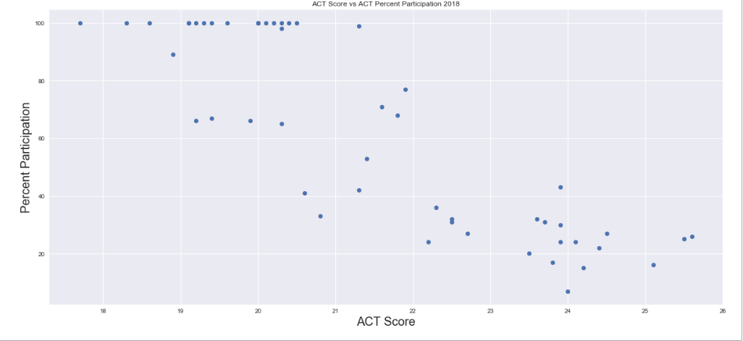
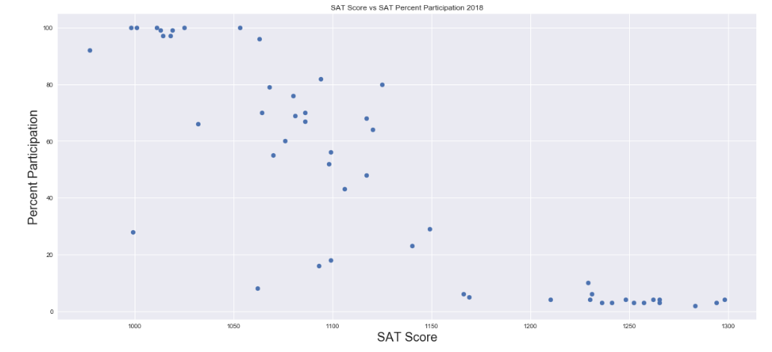
ACT and SAT as it relates to percent participation Possible Factors - Sample Size - Eager Students - Education Facility

Slide 4




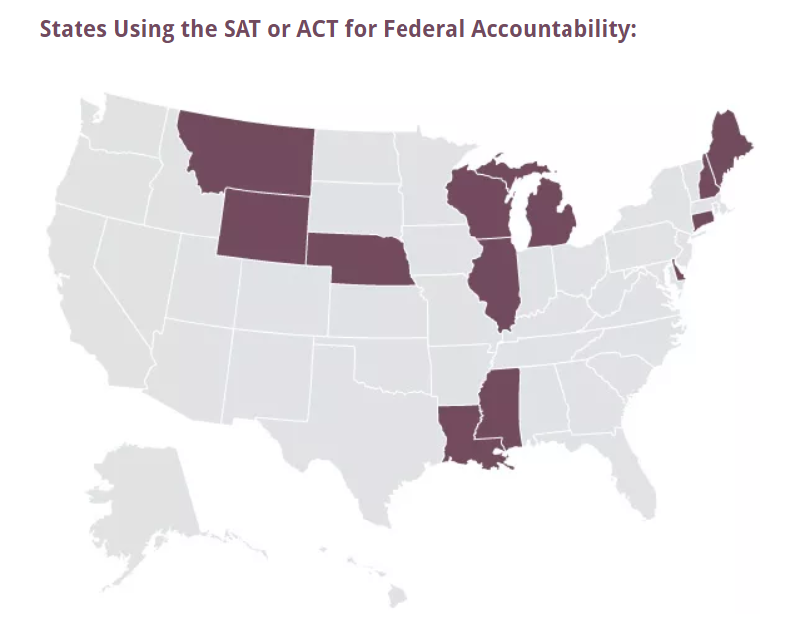
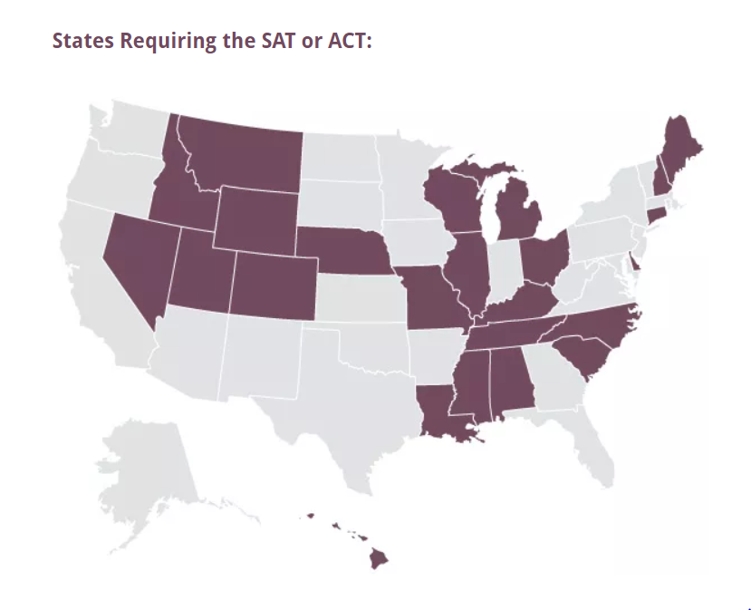
Whose doing it right and how can we get there?
Top States and Scores 2018 SAT | Top States and Scores 2017 SAT | Top States and Scores 2018 ACT | Top States and Scores 2017 ACT

Slide 5
Lets take a closer look
The Ones that Stayed
On High SAT
The Ones that Stayed
On High ACT
Minnesota
Wisconsin
Kansas
Iowa
In the Midwest the SAT is viewed as a backup exam. Ambitious students bent on Ivy Leagues are more likely to take the SATs
Link- https://www.forbes.com/sites/bentaylor/2014/07/17/why-the-midwest-dominates-the-sat/#72aa9e622f37
Connecticut
Massachusetts
New Hampshire
The second sampling as well, less students and the students who are likely to these exams have already taken the SATs

Slide 6
Conclusion:
Sample bias can have an impact on the data
Compulsion does NOT correlate to high test value
Preparatory exams aren’t always the best indicator for how well you will do in school
It takes grit, passion, and determination
On top of a good school system and income class.
Source: https://www.ncbi.nlm.nih.gov/pmc/articles/PMC4776299/

